Slide 1

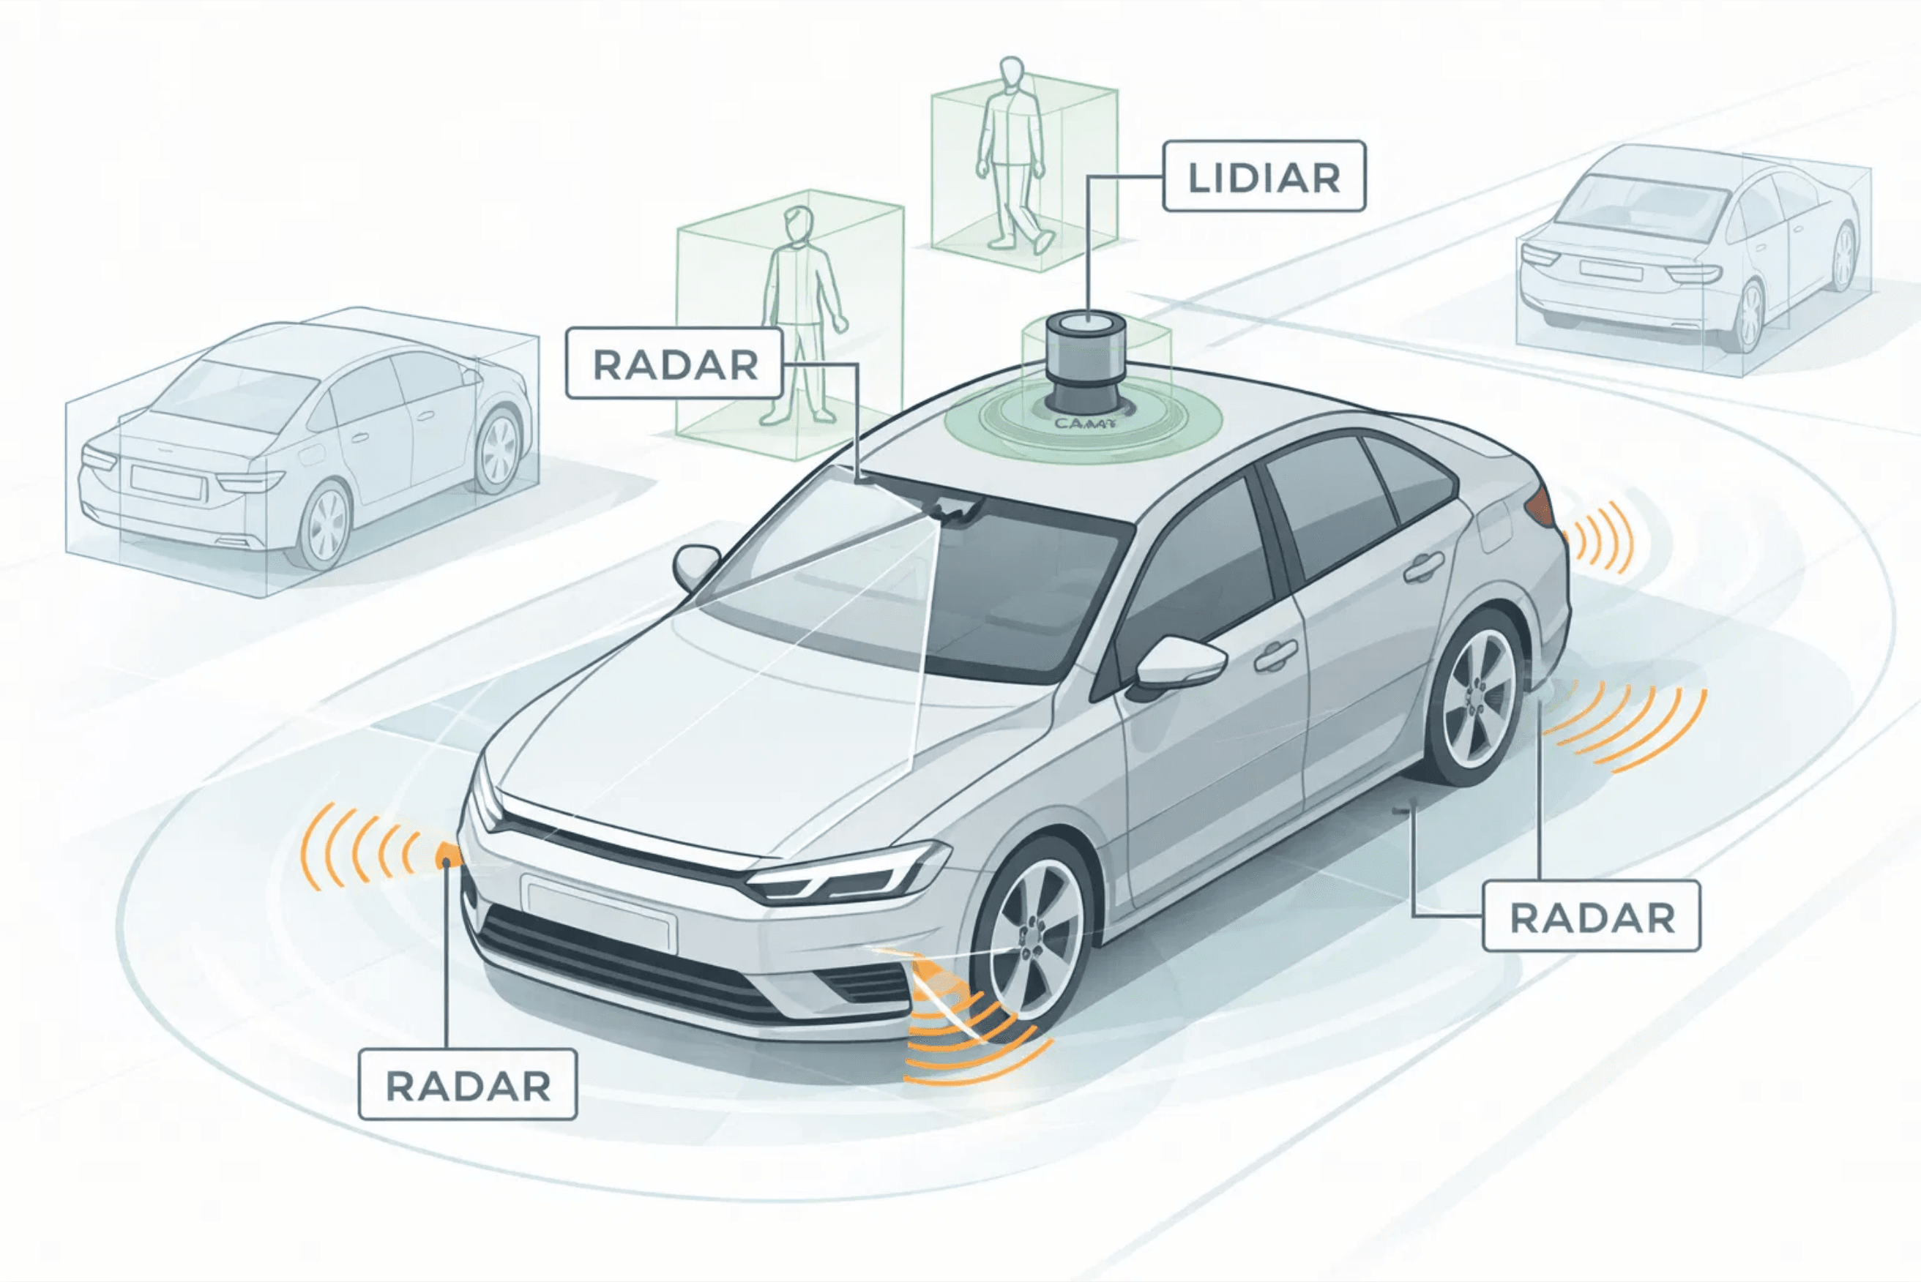
YOLO and LiDAR Fusion for Real-Time Object Detection and Tracking in Autonomous Systems
Comparative Analysis of YOLOv8, YOLO11, and YOLO12 Architectures
Ayan Ali
Supervisor
ITMO University
Professor Kirill Artemov
Faculty of Control Systems and
Robotics
Location
Saint Petersburg, 2026
01

Slide 2
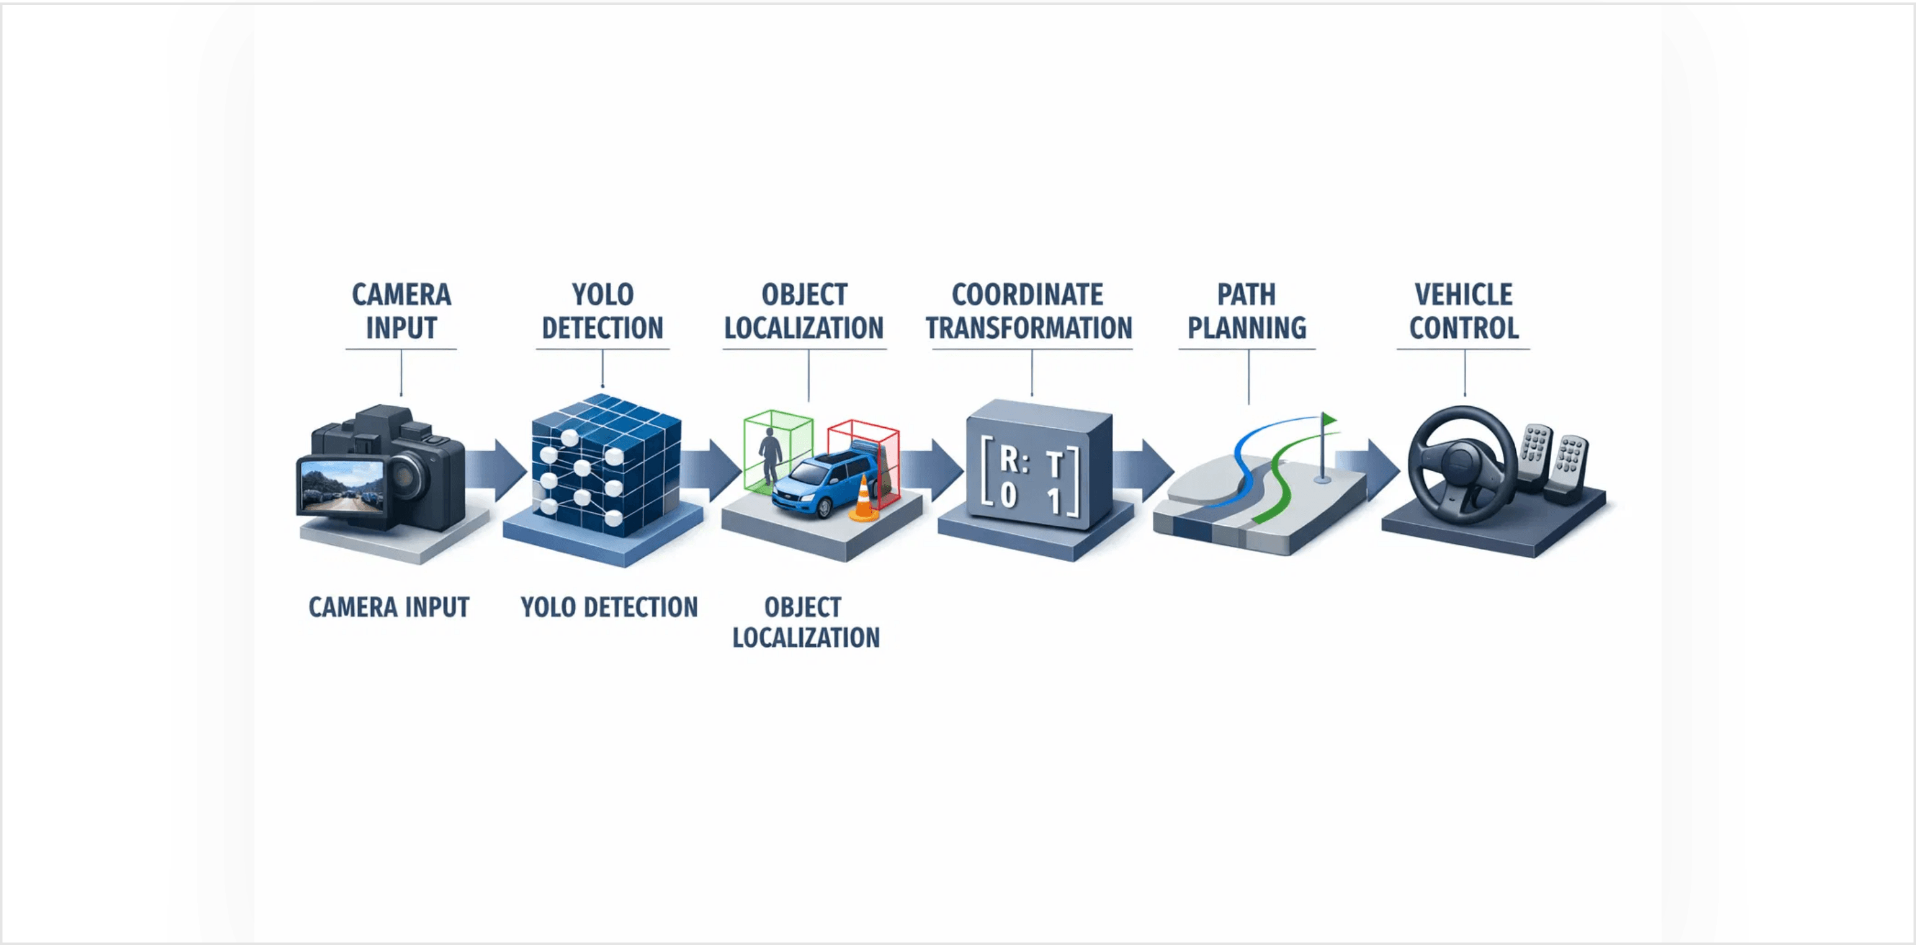
Autonomous Vehicle Perception: Research Objectives
02
Project Context
To achieve reliable navigation in cluttered environments, this project develops a robust, real-time hierarchical architecture. This system integrates perception, path planning, and motion control into a modular stack.
By establishing this foundation first, the system is prepared for the next phase: enhancing environmental awareness through real-time object detection and sensor fusion (YOLO and LiDAR). This approach ensures that high-level perception is built upon a reliable and scalable navigation framework.
`
Core Objectives
Implement state-of-the-art YOLO architectures (v8, 11, 12).
Establish performance benchmarks for real-time detection.
Bridge the gap between raw sensor data and trajectory planning.
Figure 1: Sensor Fusion & Control Pipeline Integration

Slide 3
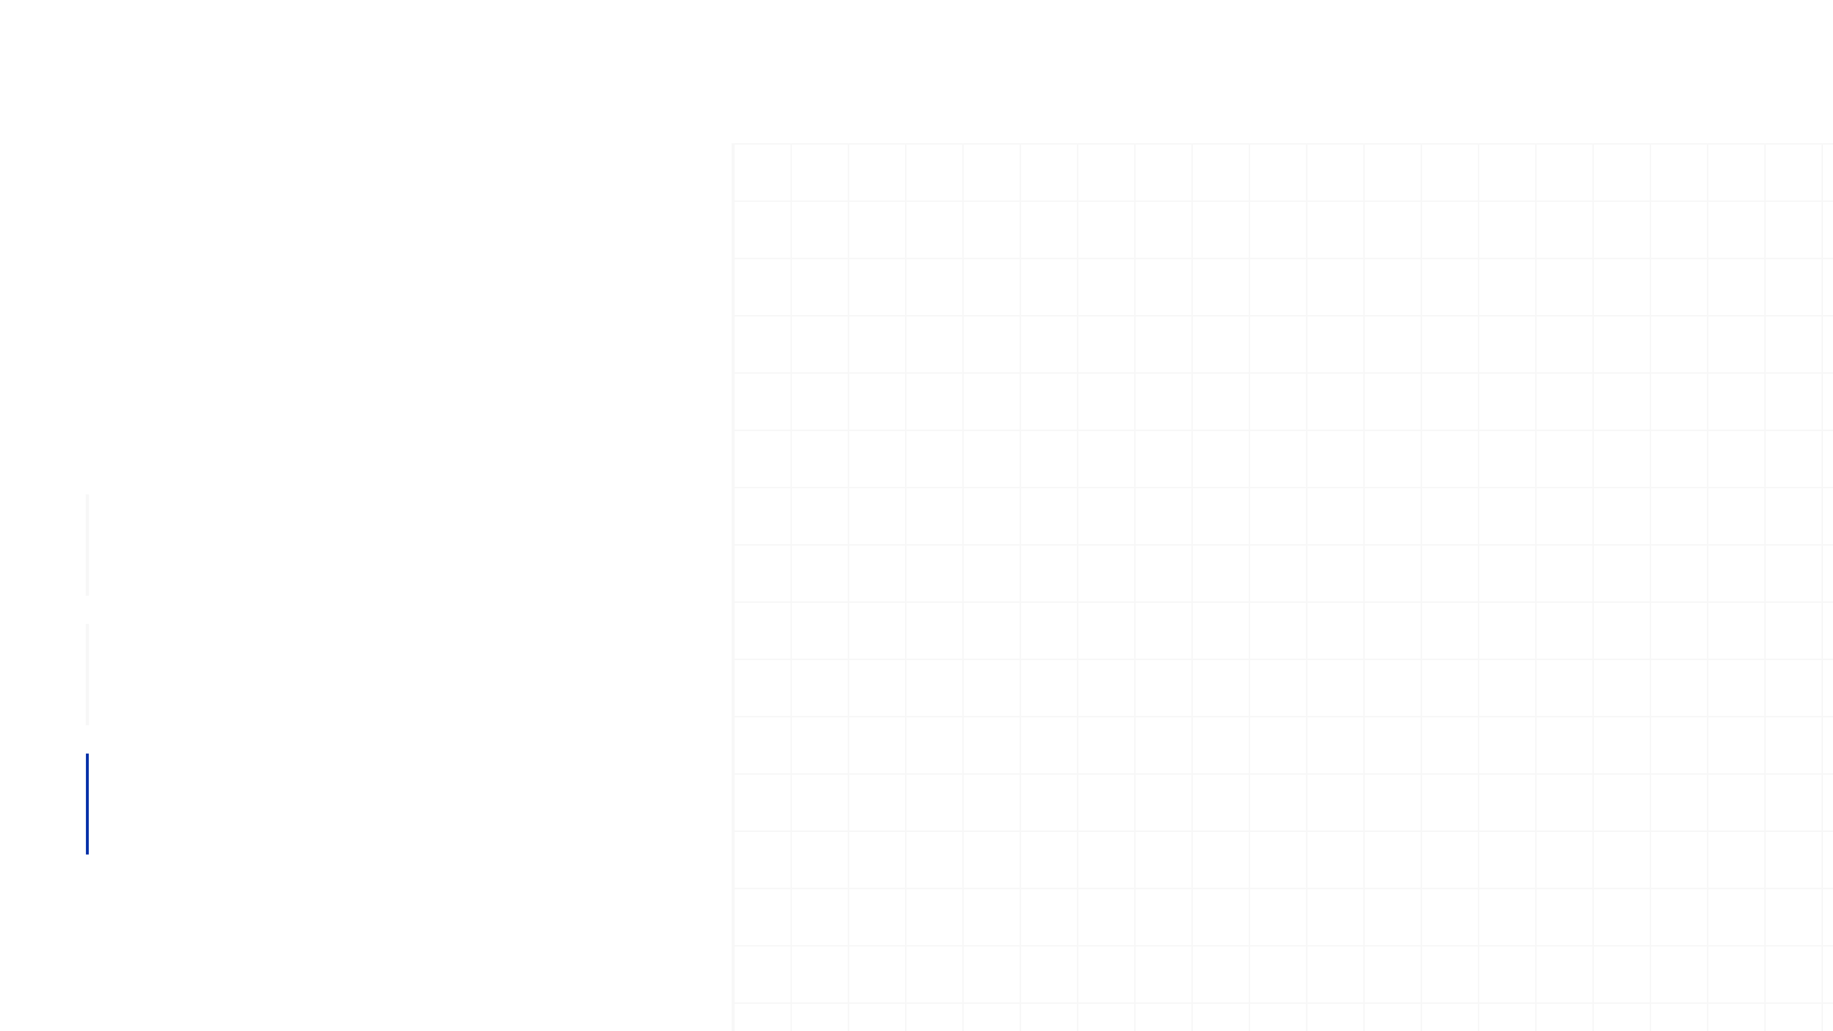
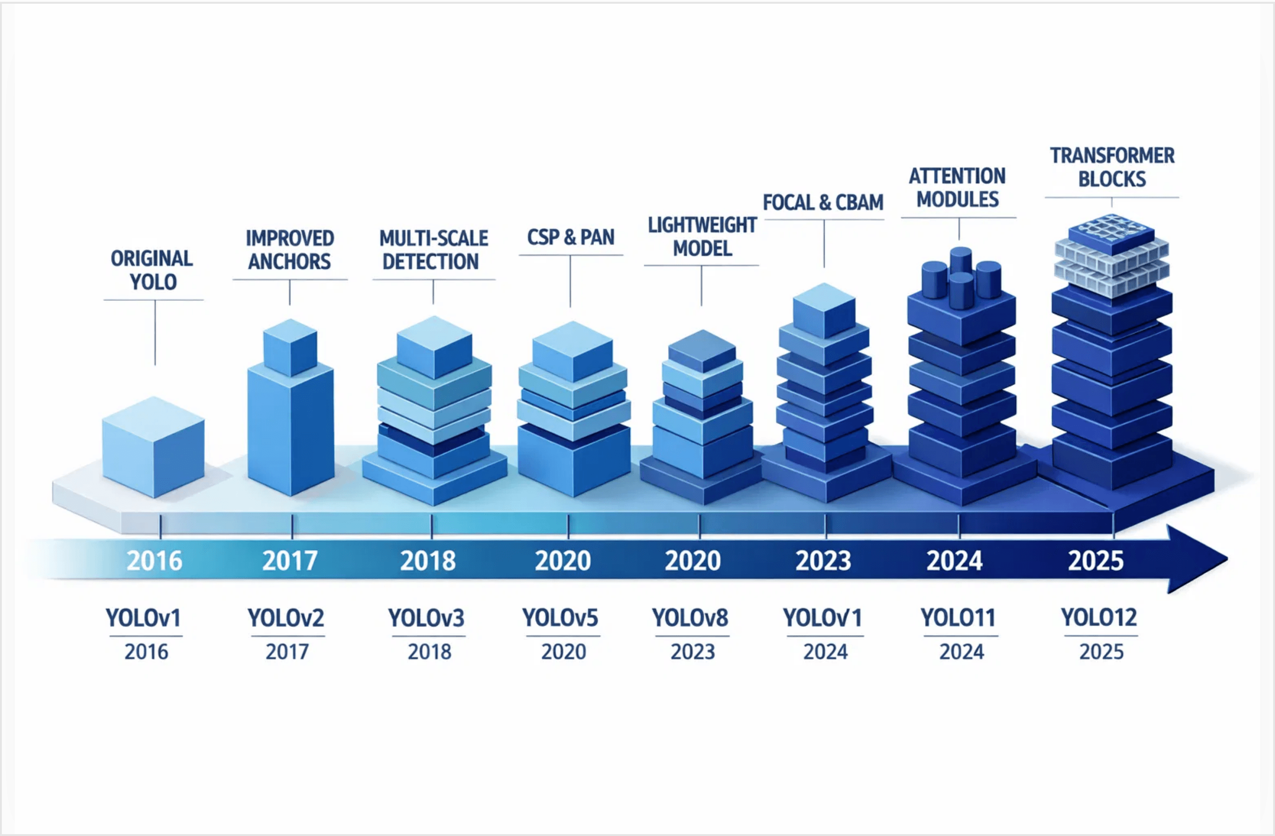
YOLO Architecture Evolution
03
Paradigm Shift
Transition from region-based proposals to single-stage regression, enabling real-time inference without sacrificing accuracy.
Architectural Milestones
YOLOv8
2023
Anchor-free detection with C2f modules & PANet.
25.9M Params | 78.9 GFLOPs
YOLO11
2024
Introduced C2PSA Self-Attention for small objects.
24.6M Params | 82.4 GFLOPs
YOLO12
2025
Hybrid CNN-Transformer with Area Attention (A2).
25.4M Params | 80.1 GFLOPs
Figure 2: Evolution of YOLO Architectures (2016-2025)

Slide 4

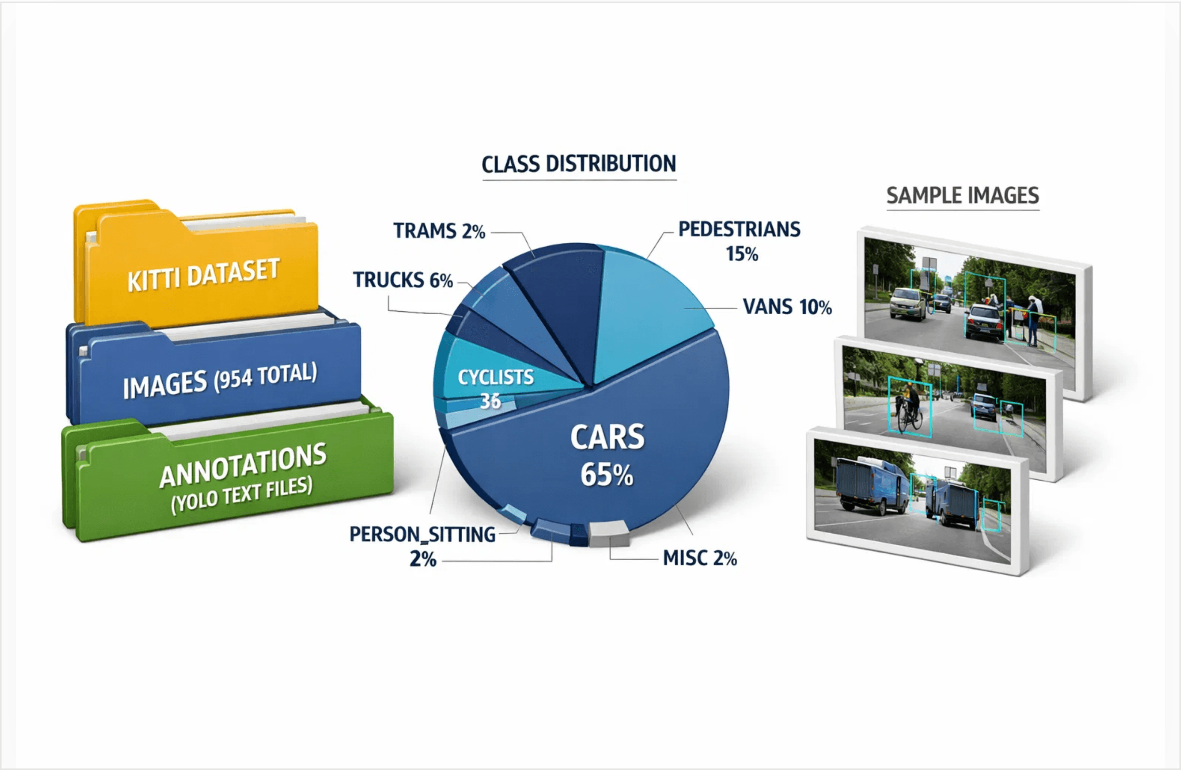
KITTI Dataset and Experimental Methodology
06
Dataset Specifications
Source
KITTI Vision Benchmark
Total Images
954
Environment
Urban / Suburban
Object Classes (8)
Significant class imbalance observed (Vehicles > VRUs).
Car
Van
Truck
Pedestrian
Person (Sitting)
Cyclist
Tram
Misc
Experimental Setup
Data Partitioning (80/20)
Training: 763 Images (80%)
Validation: 191 Images (20%)
Figure 5: Dataset Structure, Class Distribution, and Sample Annotations

Slide 5
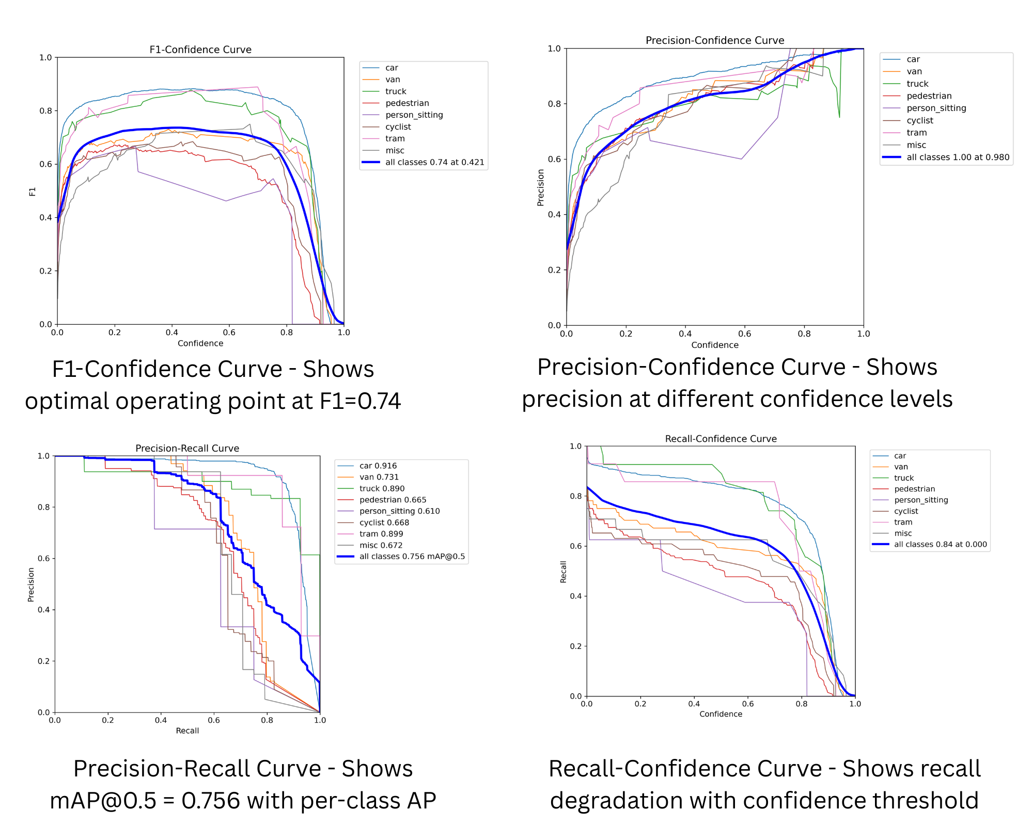
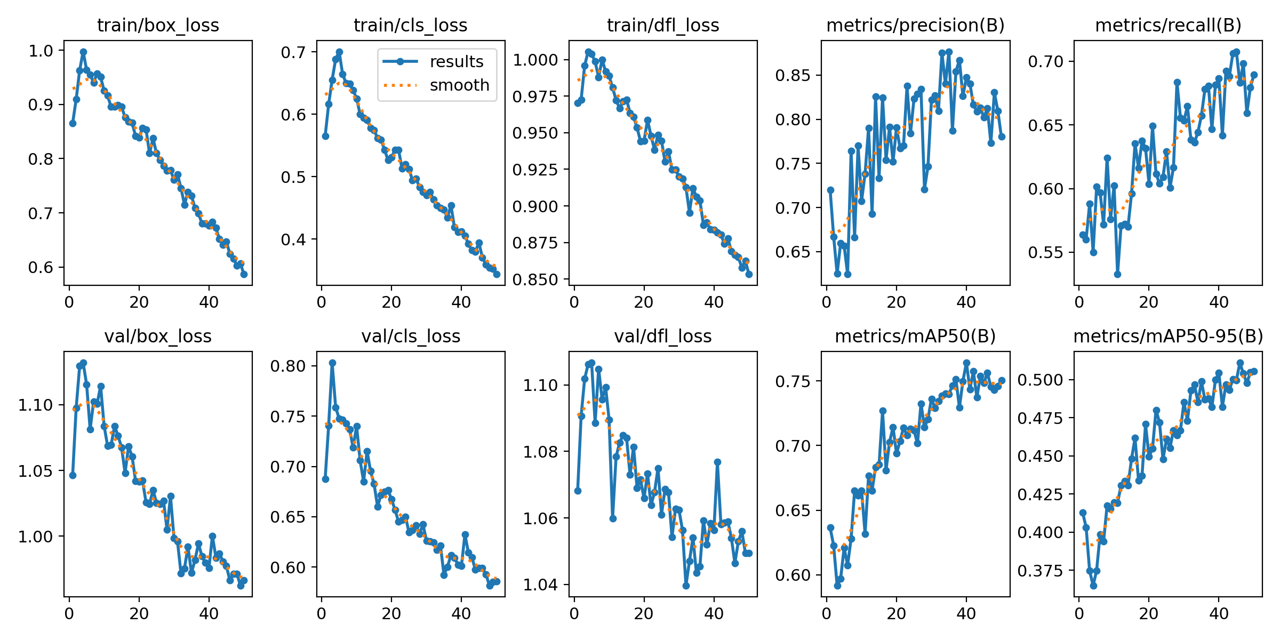
Results
Training and validation metrics for YOLOv8 showing loss convergence and performance evolution over epochs
mAP@0.5:0.95: 0.487 (50.92%)
mAP@0.5: 0.756 (75.6%)
YOLOv8 confidence-based performance analysis and precision-recall trade-offs

Slide 6
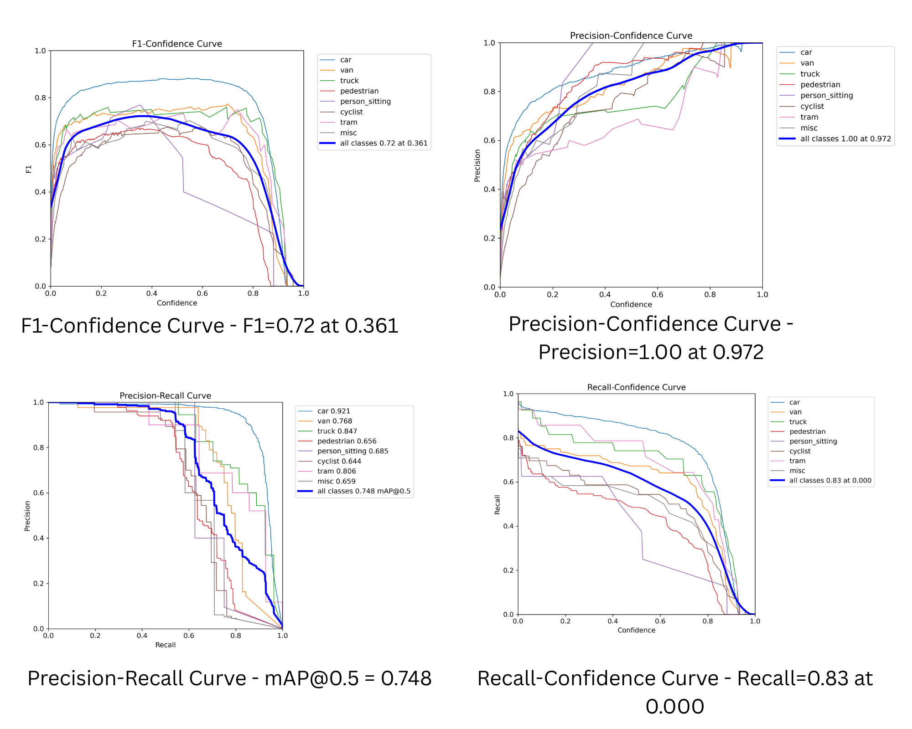
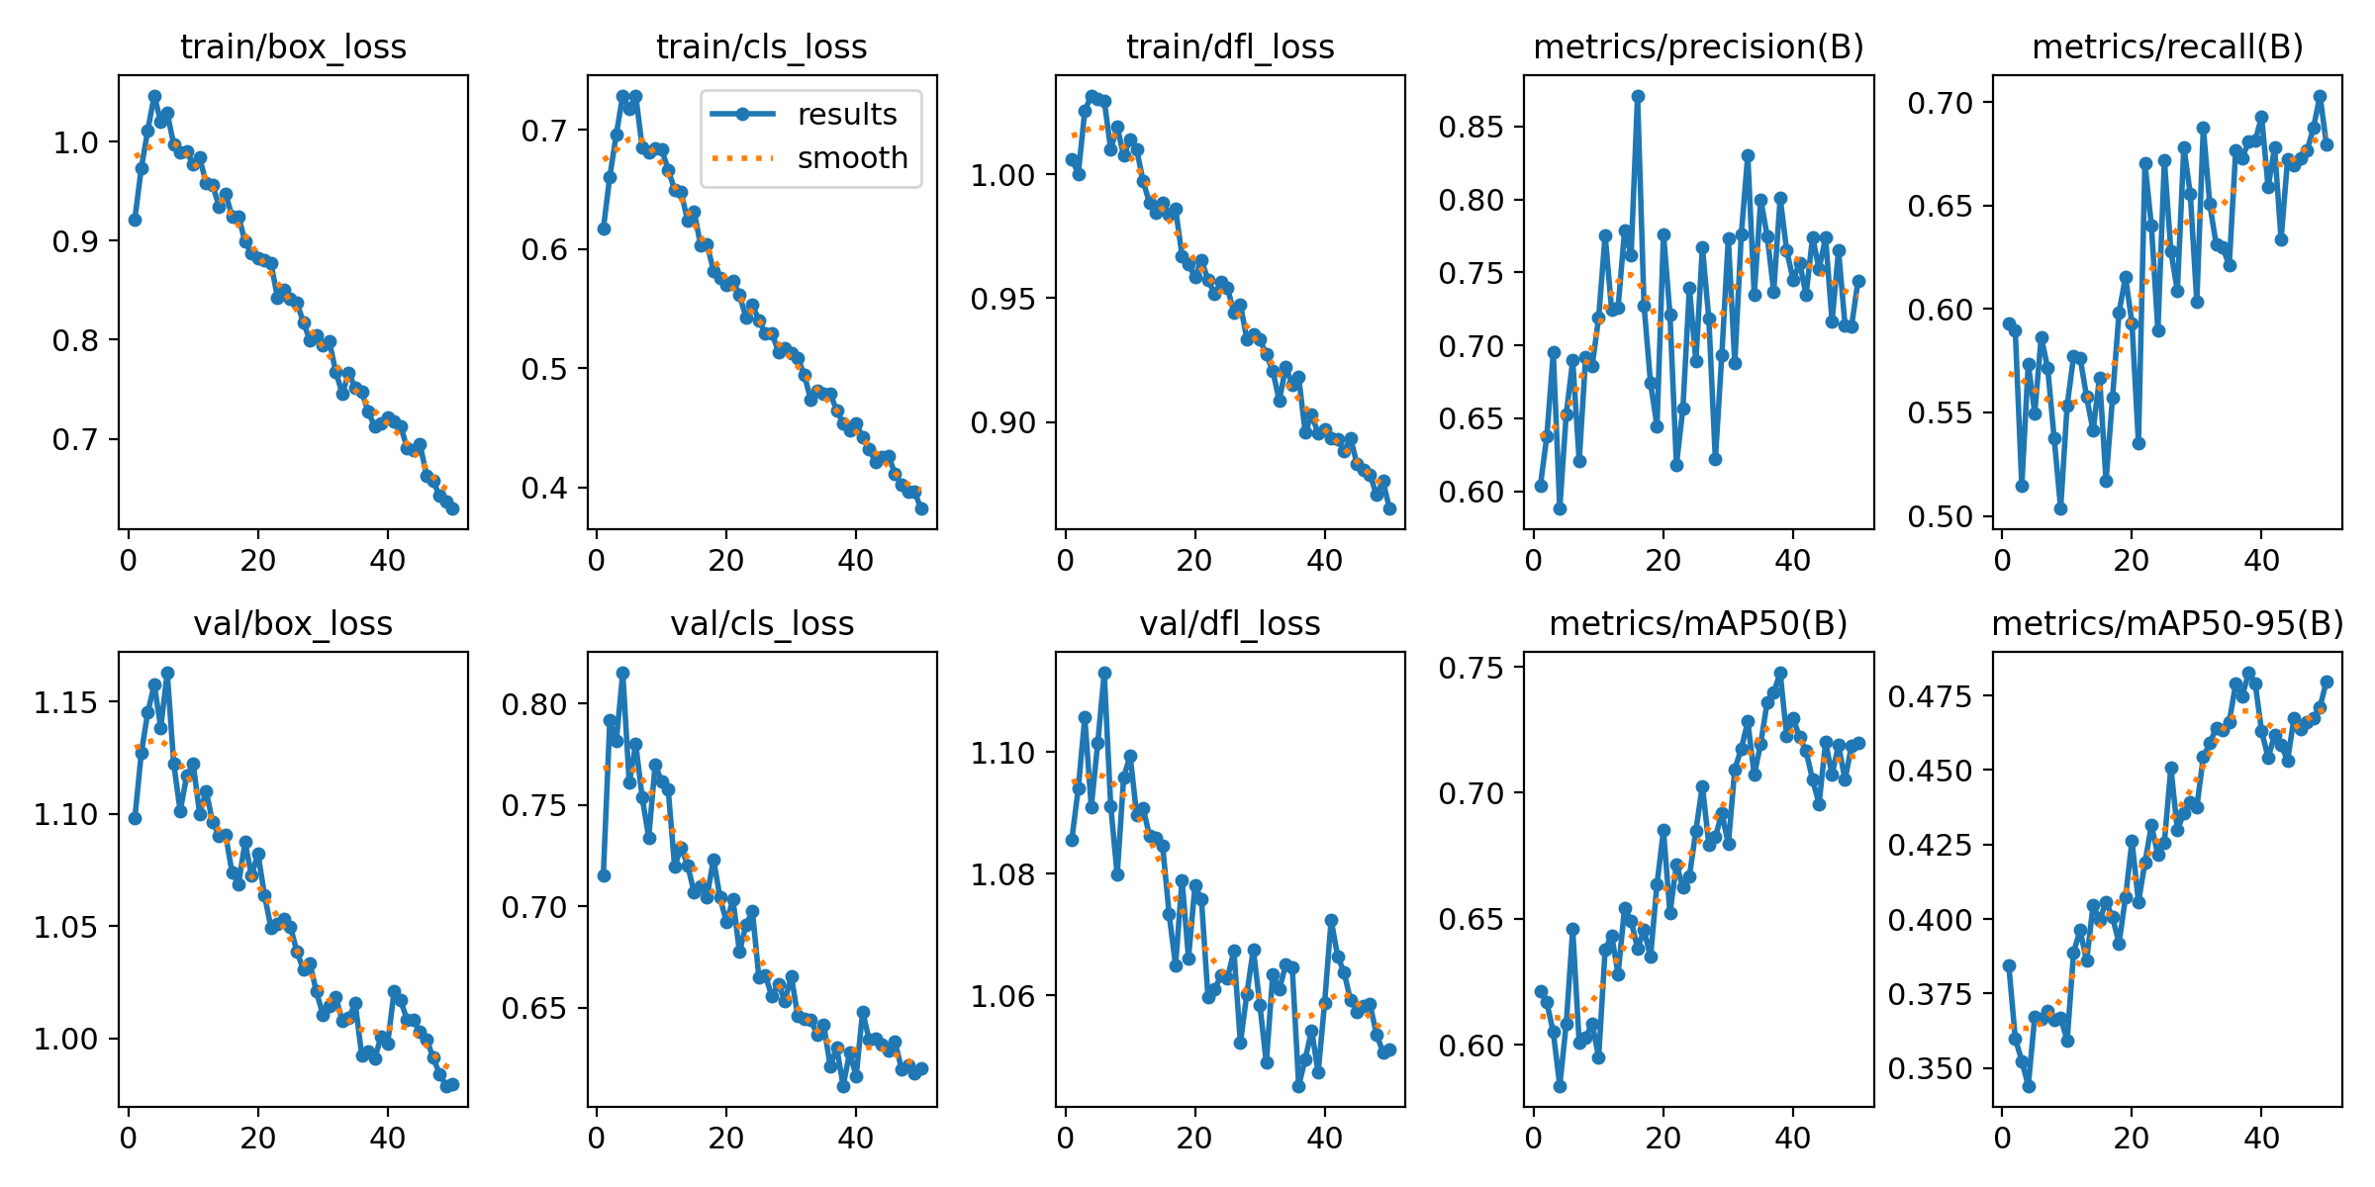
Results
Training and validation metrics for YOLO11 showing loss convergence and performance evolution over epochs
mAP@0.5:0.95: 0.502 (48.51%)
mAP@0.5: 0.748 (74.8%)
YOLO11 confidence-based performance analysis and precision-recall trade-offs

Slide 7
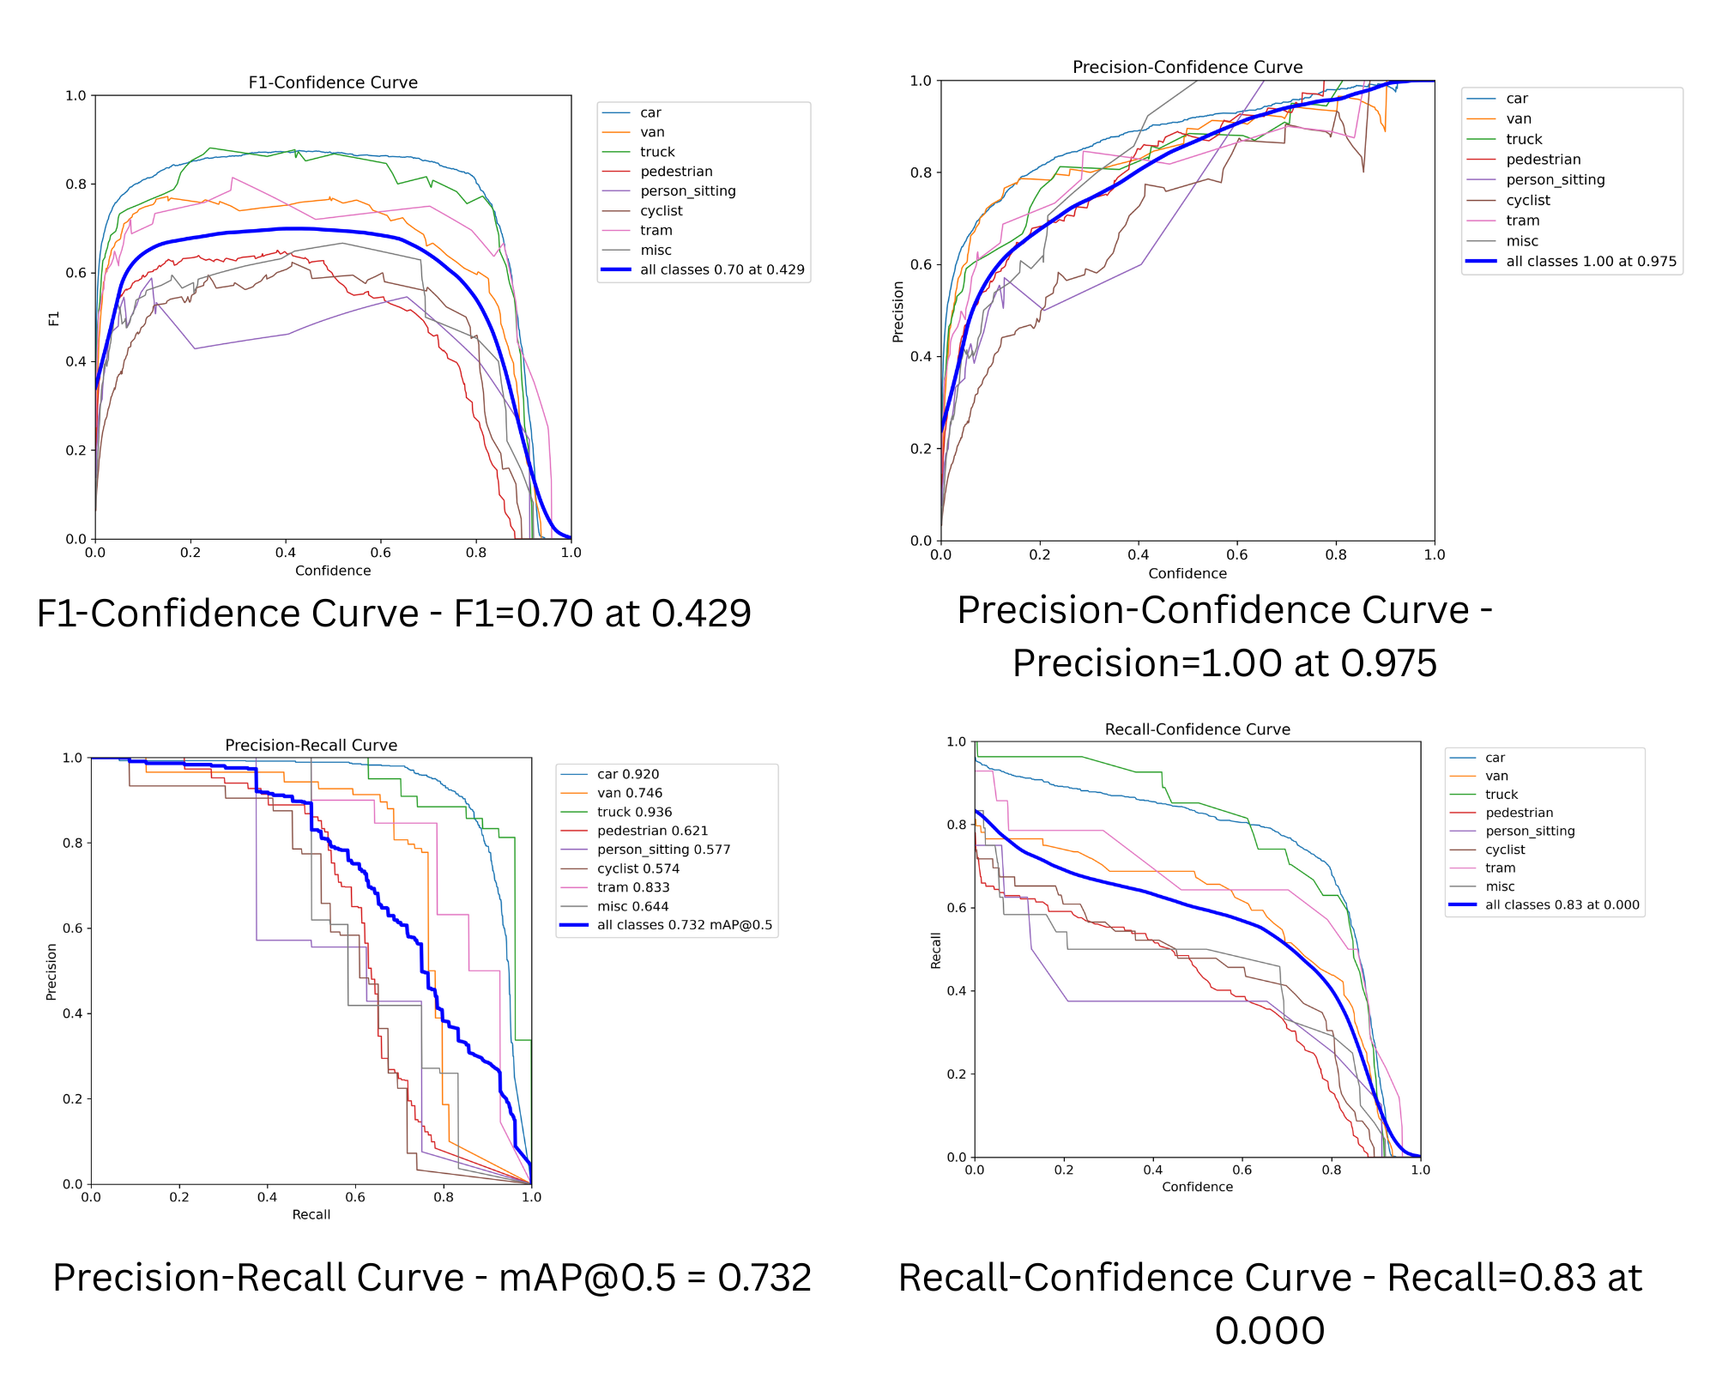
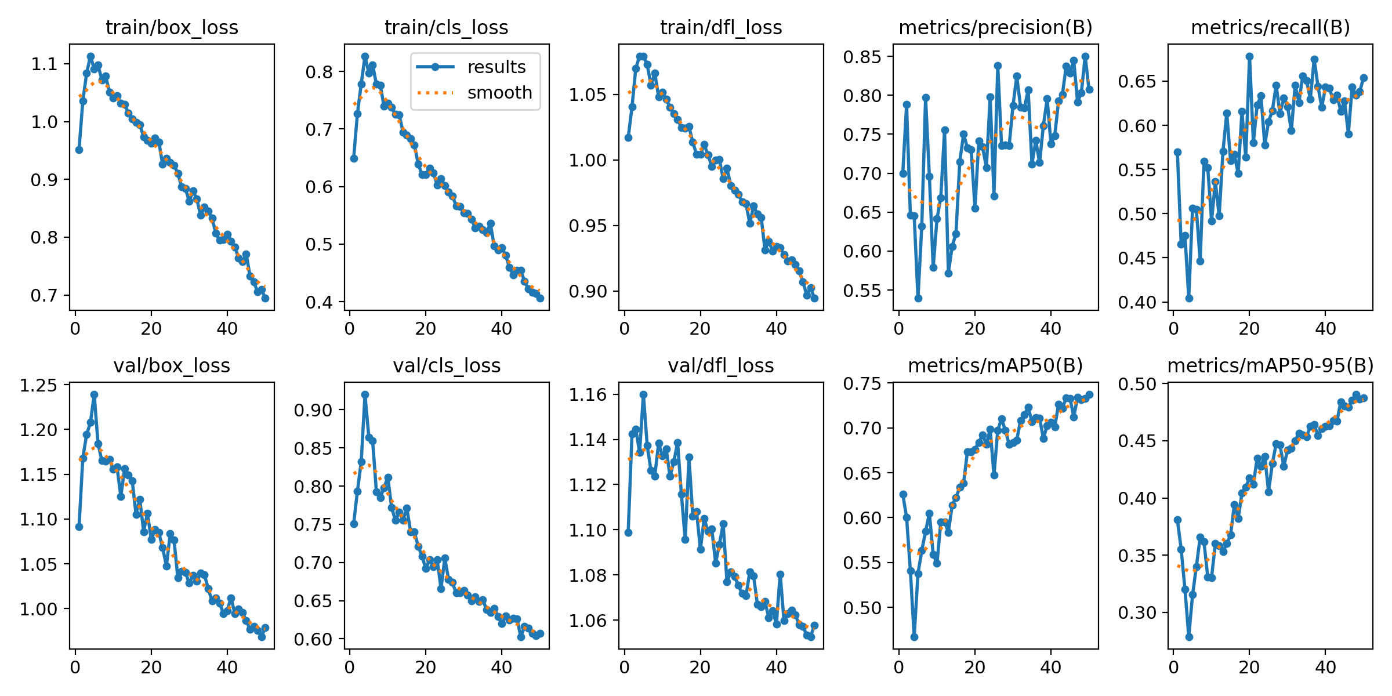
Results
Training and validation metrics for YOLO12 showing loss convergence and performance evolution over epochs
mAP@0.5:0.95: 0.495 (49.20%)
mAP@0.5: 0.732 (73.2%)
YOLO12 confidence-based performance analysis and precision-recall trade-offs

Slide 8
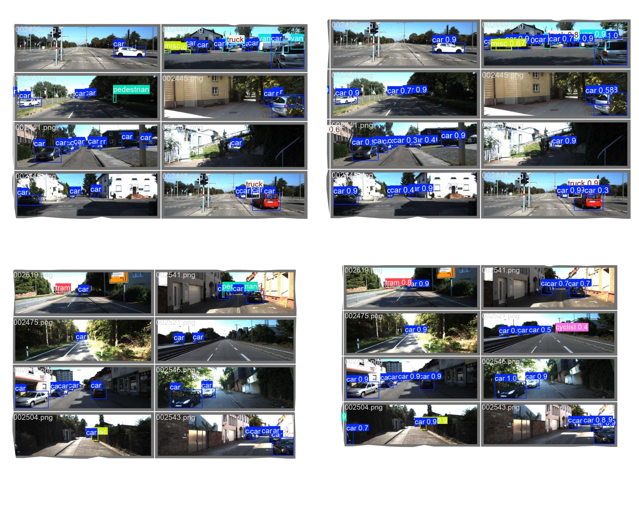
Validation Dataset

Slide 9



Quantitative Performance Comparison
10
Performance Profile
YOLOv8
Speed King
45 FPS
| 75.6% mAP@0.5
Best for real-time applications on constrained hardware.
YOLO11
Accuracy King
50.2% mAP@0.5:0.95
| 42 FPS
Superior localization and recall for safety-critical tasks.
YOLO12
Balanced
82.6% Precision
| 44 FPS
Optimal trade-off between speed and false positive reduction.
Figure 4: Comparative Metrics (mAP, Precision, Recall, FPS)
Deployment Verdict
All models exceed the 30 FPS real-time threshold. Selection depends on specific priority: latency (v8) vs. robustness (11/12).
Figure 5: Multi-Dimensional Performance Trade-offs

Slide 10

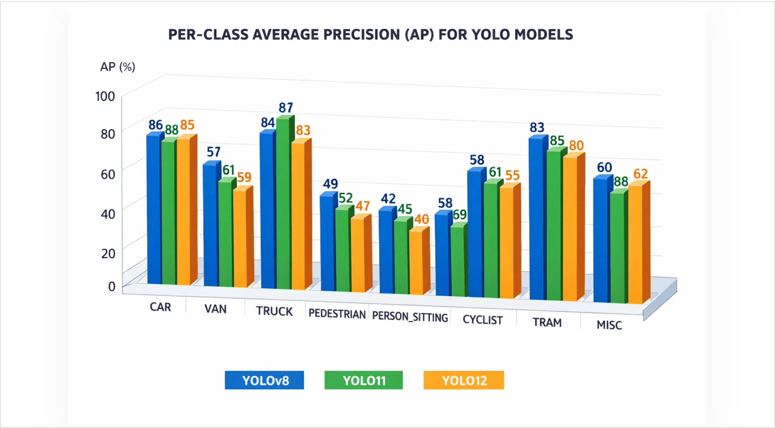
Per-Class Detection Performance
11
Tier 1: Excellent (>80% AP)
Car
88-89%
Truck
81-89%
Tram
79-86%
Tier 2: Moderate (50-70% AP)
Van
66-72%
Cyclist
59-61%
Pedestrian
51-60%
Tier 3: Challenging (<50% AP)
Person (Sitting)
37-62%
Critical Insight
Vehicle detection consistently outperforms Vulnerable Road Users (VRUs). Small object detection remains a safety-critical challenge despite attention mechanisms.
Figure 4: Comparative Analysis of Per-Class Average Precision (AP)

Slide 11
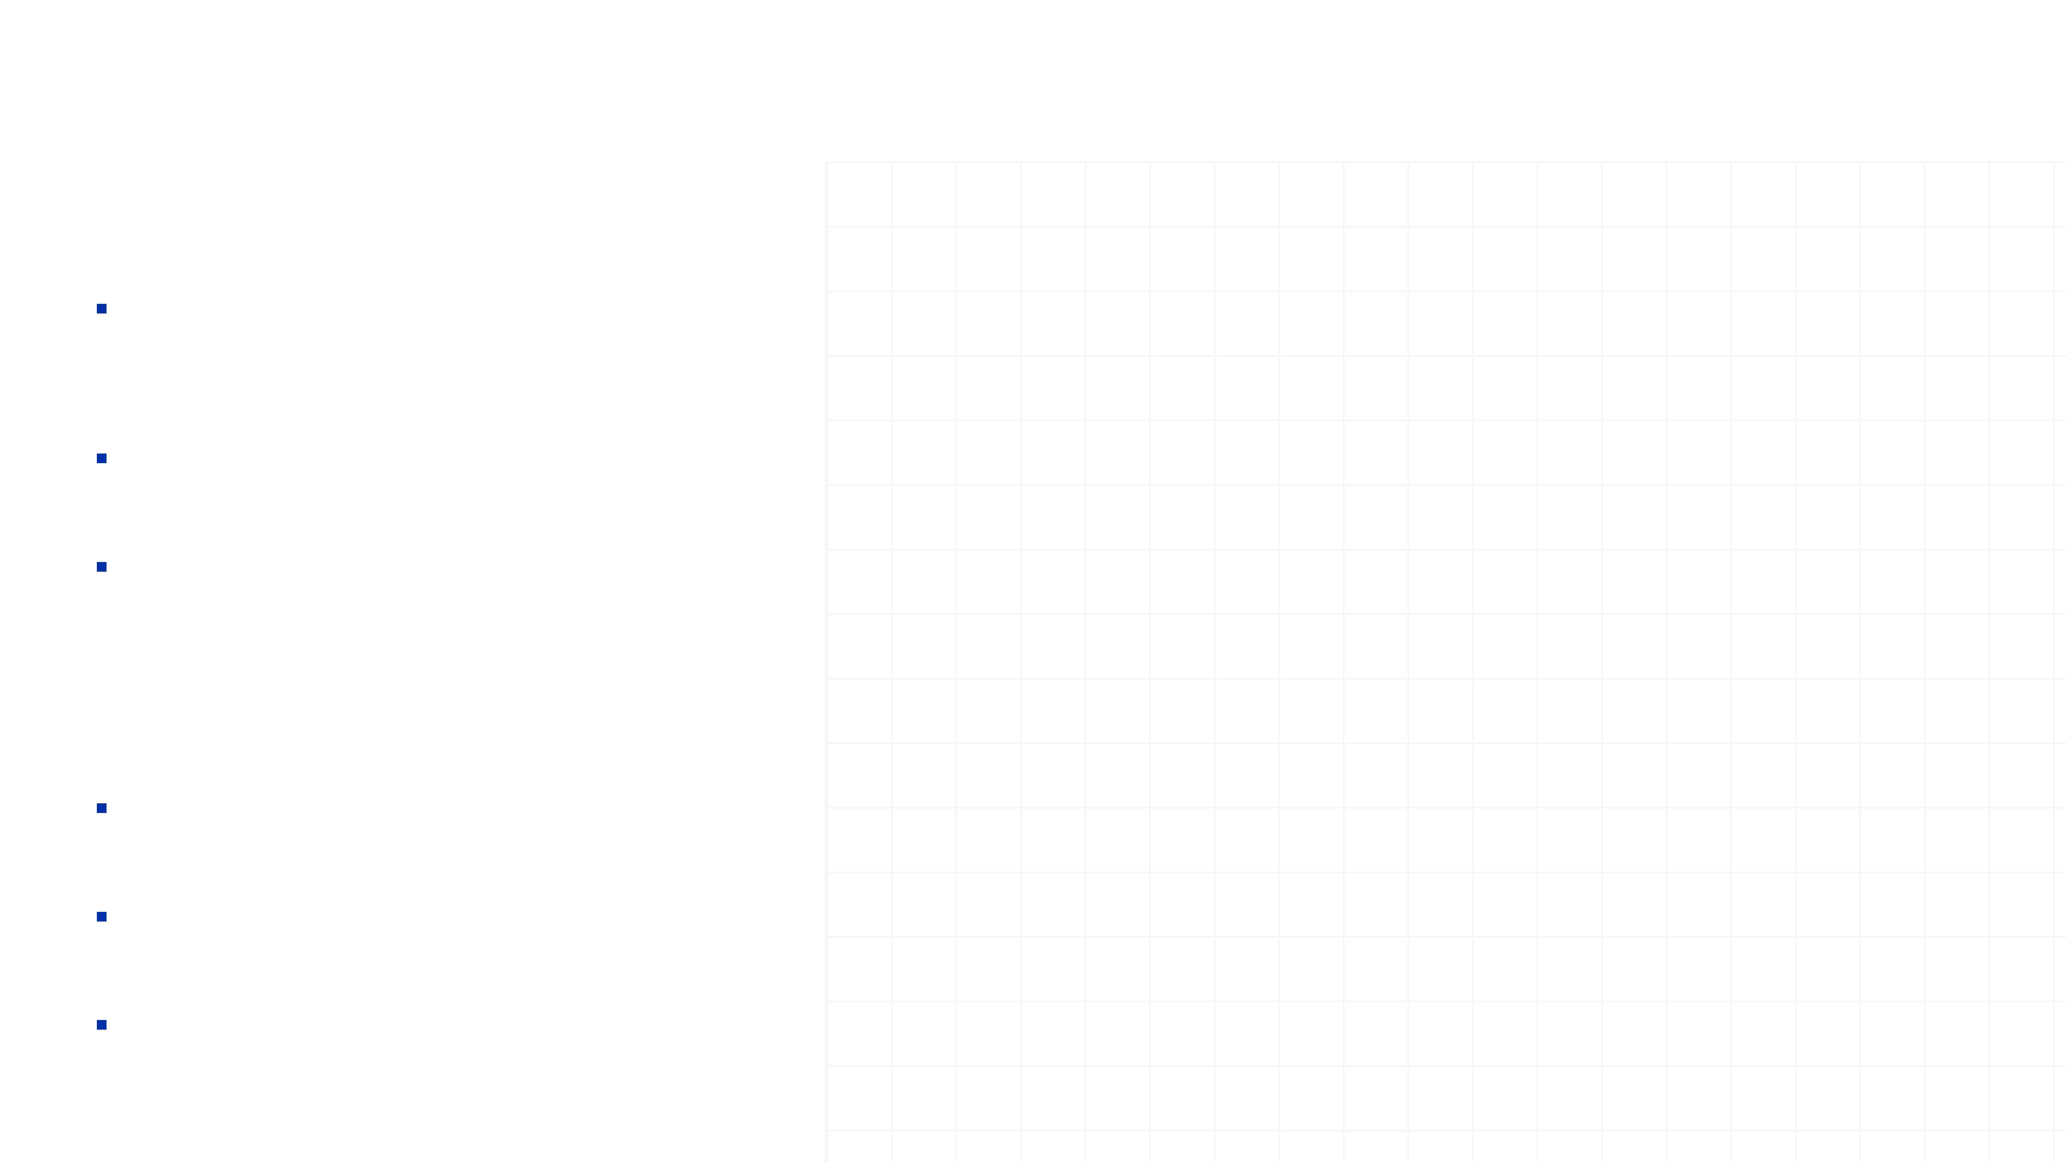
Conclusions and Path to Integration
12
Research Outcomes
Model Selection:
YOLOv8 recommended for latency-critical tasks; YOLO12 for complex urban environments.
Feasibility:
All architectures validated for real-time inference (>30 FPS) on target hardware.
Constraint:
Class imbalance remains a bottleneck for VRU safety assurance.
Future Goal
Temporal Consistency:
Integrate DeepSORT/ByteTrack for multi-object tracking.
Sensor Fusion:
Fuse 2D bounding boxes with LiDAR point clouds for 3D localization.
Deployment:
Port optimized models to NVIDIA Jetson Orin for closed-loop field testing.

